Slide 1
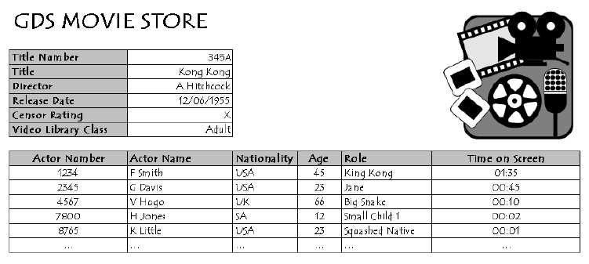
Conversion to 2nd Normal Form (2NF) - Tutorial 4
Question
Convert the GDS Movie Store data provided below to the 2nd Normal Form (2NF)

